Slide 1
ECE 532
CHAPTER 2: FUNDAMENTAL DATA STRUCTURES: RECURSION
Lecturer: Dr. Roslina Mohamad
Room: Tower 2, Level 13, No:14C

Slide 2
Learning Outcomes
At the end of this lecture, you will be able to:
Learn about recursive definitions
Explore the base case and the general case of a recursive definition
Discover what is a recursive algorithm
Learn about recursive functions
Explore how to use recursive functions to implement recursive algorithms

Slide 3
Introduction to Recursion
A recursive function is a function that calls itself.
Recursive functions can be useful in solving problems that can be broken down into smaller or simpler subproblems of the same type. A base case should eventually be reached, at which time the breaking down (recursion) will stop.

Slide 4
Recursive Functions
Consider a function for solving the count-down problem from some number num down to 0:
The base case is when num is already 0: the problem is solved and we “blast off!”
If num is greater than 0, we count off num and then recursively count down from num-1

Slide 5
Recursive Functions
A recursive function for counting down to 0:
void countDown(int num)
{
if (num == 0)
cout << "Blastoff!";
else
{
cout << num << ". . .";
countDown(num-1); // recursive
} // call
}

Slide 6
What Happens When Called?
If a program contains a line like countDown(2);
countDown(2) generates the output 2..., then it calls countDown(1)
countDown(1) generates the output 1..., then it calls countDown(0)
countDown(0) generates the output Blastoff!, then returns to countDown(1)
countDown(1) returns to countDown(2)
countDown(2)returns to the calling function
Notes:
See pr14-01.cpp, pr14-02.cpp

Slide 7
What Happens When Called?
first call to
countDown
num is 2
OUTPUT:
2...
countDown(1);
second call to
countDown
num is 1
1...
countDown(0);
third call to
countDown
num is 0
Blastoff!
// no
// recursive
// call

Slide 8
Stopping the Recursion
A recursive function should include a test for the base cases
In the sample program, the test is:
if (num == 0)

Slide 9
Stopping the Recursion
void countDown(int num)
{
if (num == 0) // test
cout << "Blastoff!";
else
{
cout << num << "...\n";
countDown(num-1); // recursive
} // call
}

Slide 10
Stopping the Recursion
With each recursive call, the parameter controlling the recursion should move closer to the base case
Eventually, the parameter reaches the base case and the chain of recursive calls terminates

Slide 11
Stopping the Recursion
void countDown(int num)
{
if (num == 0) // base case
cout << "Blastoff!";
else
{ cout << num << "...\n";
countDown(num-1);
}
}
Value passed to recursive call is closer to base case of num = 0.

Slide 12
What Happens When Called?
Each time a recursive function is called, a new copy of the function runs, with new instances of parameters and local variables being created
As each copy finishes executing, it returns to the copy of the function that called it
When the initial copy finishes executing, it returns to the part of the program that made the initial call to the function
Notes:
See pr14-03.cpp

Slide 13
Example
Example 2.1
Example 2.2

Slide 14
Recursive Definitions
Recursion: solving a problem by reducing it to smaller versions of itself
0! = 1 (1)
n! = n x (n-1)! if n > 0 (2)
The definition of factorial in equations (1) and (2) is called a recursive definition
Equation (1) is called the base case
Equation (2) is called the general case

Slide 15
Recursive Definitions
Recursive definition: defining a problem in terms of a smaller version of itself
Every recursive definition must have one (or more) base cases
The general case must eventually reduce to a base case
The base case stops the recursion

Slide 16
Recursive Definitions
Recursive algorithm: finds a solution by reducing problem to smaller versions of itself
Must have one (or more) base cases
General solution must eventually reduce to a base case
Recursive function: a function that calls itself
Recursive algorithms are implemented using recursive functions

Slide 17
The Recursive Factorial Function
The factorial of a nonnegative integer n is the product of all positive integers less or equal to n
The factorial of n is denoted by n!
The factorial of 0 is 1
0 ! = 1
n ! = n x (n-1) x … x 2 x 1 if n > 0

Slide 18
Recursive Factorial Function
Factorial of n can be expressed in terms of the factorial of n-1
0 ! = 1
n ! = n x (n-1) !
Recursive function
int factorial(int n)
{ if (n == 0) return 1;
else
return n *factorial(n-1);
}
//See Example 2.3, Example 2.4
Notes:
See pr14-04.cpp

Slide 19
The Recursive gcd Function
Greatest common divisor (gcd) of two integers x and y is the largest number that divides both x and y
The Greek mathematician Euclid discovered that
If y divides x, then gcd(x, y) is just y
Otherwise, the gcd(x, y) is the gcd of y and the remainder of dividing x by y

Slide 20
The Recursive gcd Function
int gcd(int x, int y)
{
if (x % y == 0) //base case
return y;
else
return gcd(y, x % y);
}
//See Example 2.5
Notes:
See pr14-05.cpp

Slide 21
Solving Recursively Defined Problems
The natural definition of some problems leads to a recursive solution
Example: Fibonacci numbers:
0, 1, 1, 2, 3, 5, 8, 13, 21, ...
After the initial 0 and 1, each term is the sum of the two preceding terms
Recursive calculation of the nth Fibonacci number:
fib(n) = fib(n – 1) + fib(n – 2);
Base cases: n == 0, n == 1
//See Fibonacci

Slide 22
Recursive Fibonacci Function
int fib(int n)
{
if (n <= 0) // base case
return 0;
else if (n == 1) // base case
return 1;
else
return fib(n – 1) + fib(n – 2);
}
//See Example 2.6
Notes:
See pr14-06.cpp

Slide 23
A Recursive Binary Search Function
Assume an array a that is sorted in ascending order, and an item X to search for
We want to write a function that searches for X within the array a, returning the index of X if it is found, and returning -1 if X is not in the array

Slide 24
Recursive Binary Search
A recursive strategy for searching a portion of the array from index lo to index hi is to
set m to the index of the middle element of the array:
lo
m
hi

Slide 25
Recursive Binary Search
If a[m] == X, we found X, so return m
If a[m] > X, recursively search a[lo..m-1]
If a[m] < X, recursively search a[m+1..hi]
lo
m
hi

Slide 26
Recursive Binary Search
int bSearch(int a[],int lo,int hi,int X)
{
int m = (lo + hi) /2;
if(lo > hi) return -1; // base
if(a[m] == X) return m; // base
if(a[m] > X)
return bsearch(a,lo,m-1,X);
else
return bsearch(a,m+1,hi,X);
}
//See Example 2.7
Notes:
See pr14-07.cpp

Slide 27
The QuickSort Algorithm
Recursive algorithm that can sort an array
First, determine an element to use as pivot value:
pivot
sublist 1
sublist 2

Slide 28
The QuickSort Algorithm
pivot value
sublist 1
sublist 2
Then, values are shifted so that elements in sublist1 are < pivot and elements in sublist2 are >= pivot
Algorithm then recursively sorts sublist1 and sublist2
Base case: a sublist has size <=1
//See Example 2.8
Notes:
See pr14-08.cpp

Slide 29
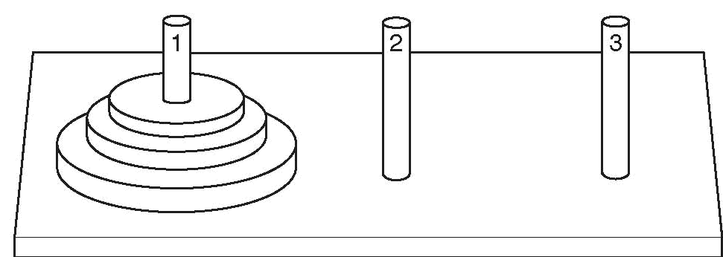
The Towers of Hanoi
Setup: 3 pegs, one has n disks on it, the other two pegs empty. The disks are arranged in increasing diameter, top→ bottom
Objective: move the disks from peg 1 to peg 3, observing these rules:
only one disk moves at a time
all remain on pegs except the one being moved
a larger disk cannot be placed on top of a smaller disk at any time

Slide 30
The Towers of Hanoi
How it works: //See Tower of Hanoi
n=1 | Move disk from peg 1 to peg 3. Done.
n=2 | Move top disk from peg 1 to peg 2. Move remaining disk from peg 1 to peg 3. Move disk from peg 2 to peg 3. Done.

Slide 31
Outline of Recursive Algorithm
If n==0, do nothing (base case)
If n>0, then
Move the topmost n-1 disks from peg1 to peg2
Move the n^{th} disk from peg1 to peg3
Move the n-1 disks from peg2 to peg3
end if
//See Example 2.9
Notes:
See pr14-09.cpp

Slide 32
Exhaustive and Enumeration Algorithms
Enumeration algorithm: generate all possible combinations
Example: all possible ways to make change for a certain amount of money
Exhaustive algorithm: search a set of combinations to find an optimal one
Example: change for a certain amount of money that uses the fewest coins
Notes:
See pr14-10.cpp

Slide 33
Direct recursion
a function calls itself
Indirect recursion
function A calls function B, and function B calls function A. Or,
function A calls function B, which calls …, which then calls function A

Slide 34
Types of Recursion
Directly recursive: a function that calls itself
Indirectly recursive: a function that calls another function and eventually results in the original function call
function A calls function B, and function B calls function A. Or,
function A calls function B, which calls …, which then calls function A
Tail recursive function: function in which the last statement executed is the recursive call
Example: the function modified_factorial (See Example 2.10)

Slide 35
Infinite Recursion
Infinite recursion: every recursive call results in another recursive call
In theory, infinite recursion executes forever
Because computer memory is finite:
Function executes until the system runs out of memory
Results in an abnormal program termination

Slide 36
Infinite Recursion
To design a recursive function:
Understand problem requirements
Determine limiting conditions
Identify base cases and provide a direct solution to each base case
Identify general cases and provide a solution to each general case in terms of smaller versions of itself

Slide 37
Recursion vs. Iteration
Benefits (+), disadvantages(-) for recursion:
Natural formulation of solution to certain problems
Results in shorter, simpler functions
May not execute very efficiently
Benefits (+), disadvantages(-) for iteration:
Executes more efficiently than recursion
May not be as natural a method of solution as recursion for some problems

